Slide 1
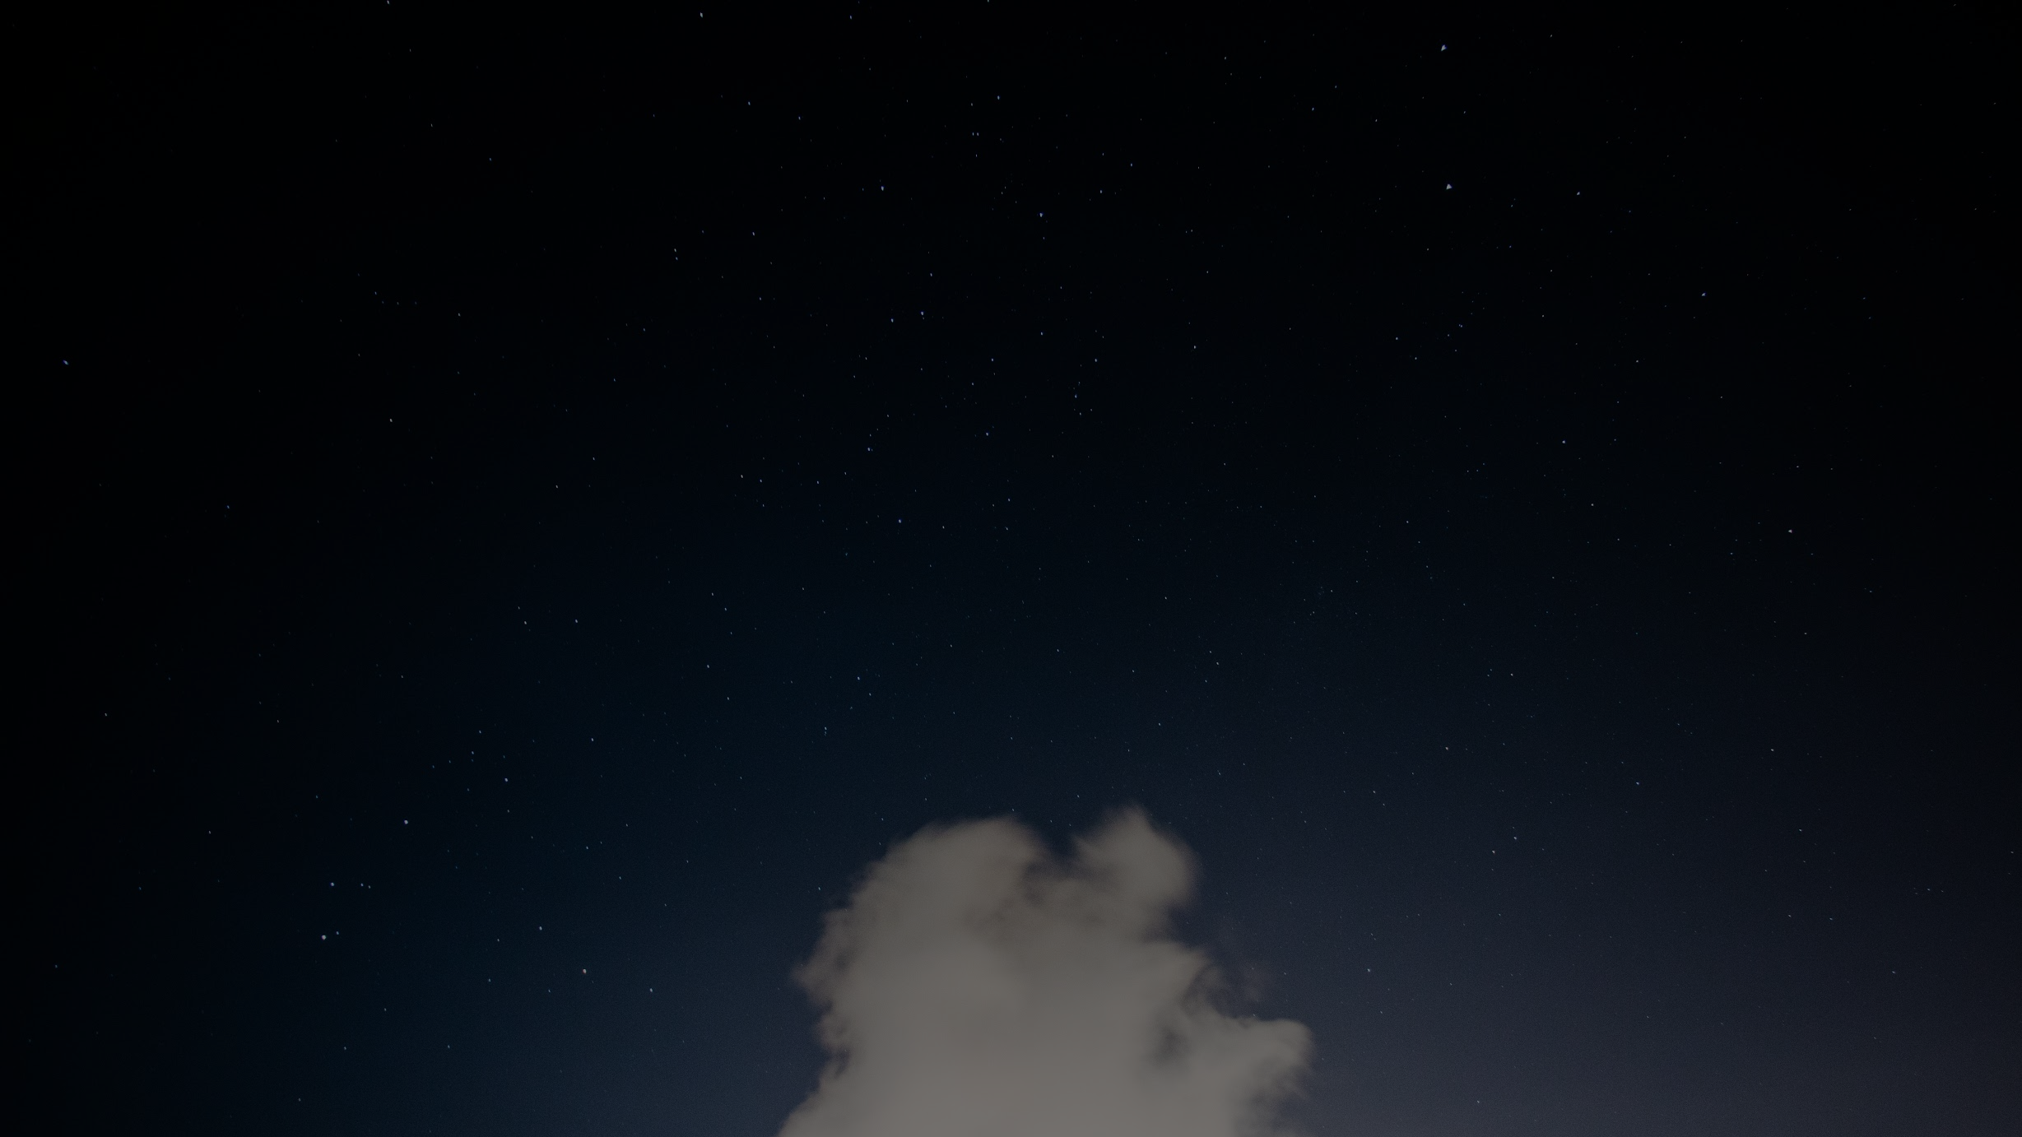
INTEL SCENE
IMAGE CLASSIFICATION
Presented By
Anusha Palisetty
Meghana Kodali

Slide 2
Contents
Problem Statement
Dataset
Preprocessing
Base Model - CNN
Other Models Used
Results
Demo

Slide 3
Problem Statement
Kaggle competition:
Intel Scene Image Classification
Classify the given images into 6 categories
Buildings
Mountain
Sea
Street
Forest
Glacier

Slide 4
Dataset
This Data contains around 25k images of size 150x150 distributed under 6 categories.
{'buildings' -> 0,
'forest' -> 1,
'glacier' -> 2,
'mountain' -> 3,
'sea' -> 4,
'street' -> 5 }
The Train, Test and Prediction data is separated in each zip files. There are around 14k images in Train, 3k in Test and 7k in Prediction.

Slide 5
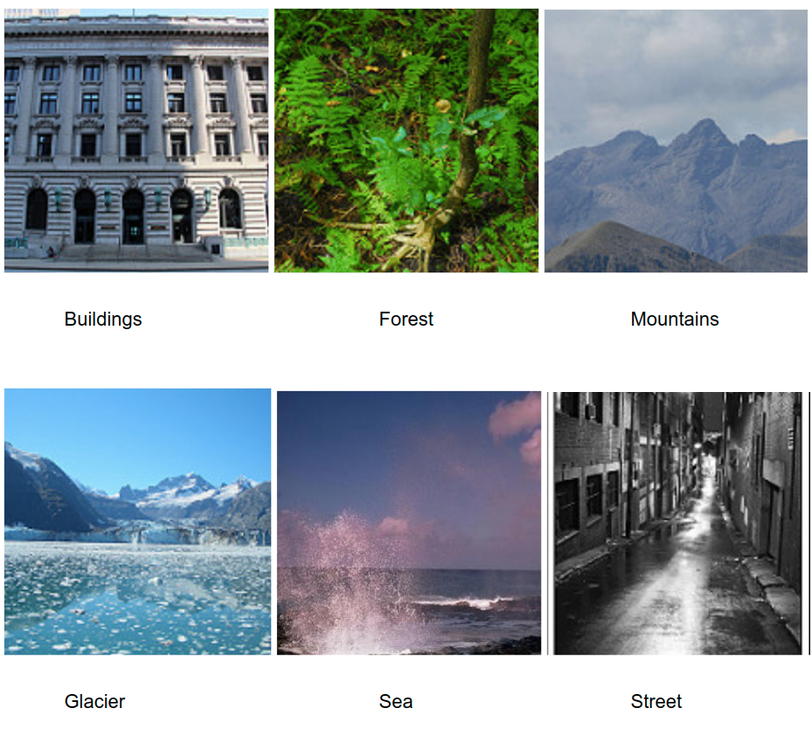
Sample Dataset

Slide 6
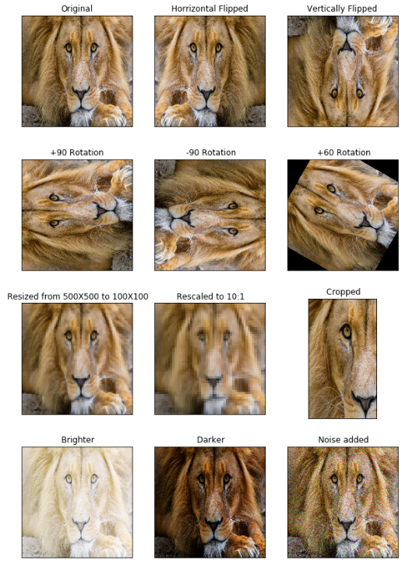
Data Augmentation
Used to generate more training data from the original data.
Most common techniques to generate new images:
Flip image
Rotate at some degrees
Scale outward or inward
Crop randomly
Translate
Add Gaussian noises

Slide 7
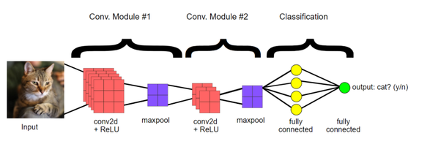
Base Model - CNN
Using Keras framework
CNN receives 150x150 RGB channel images
Has a sequence of 5 convolutional and MaxPool layers to interpret features
Output layer with a softmax activation for multi class classification

Slide 8
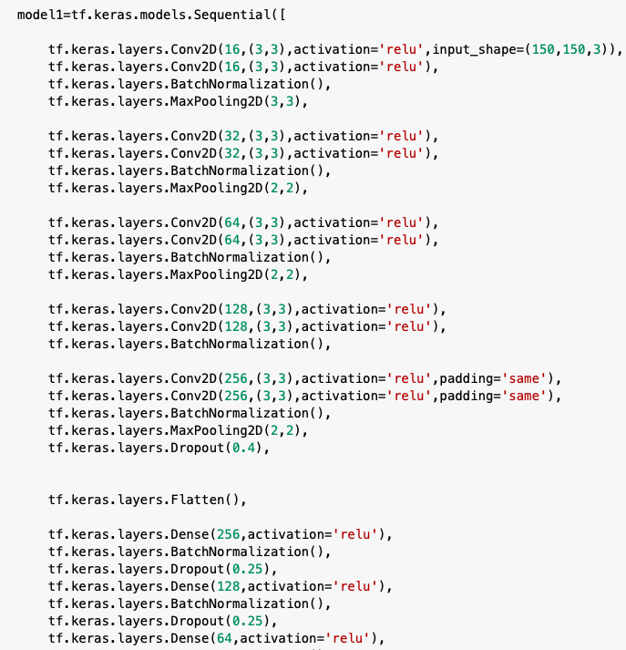
CNN
Sequential model
Conv2D
Activation Function- ReLU
Batch Normalization
Max Pooling
Flatten
Dense Layer
Dropout Regularization

Slide 9
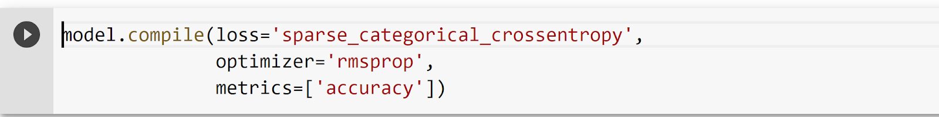
CNN Model Compilation
Optimizer: “Root Mean Square Propagation”, it calculates the average of squares of the gradients and divides the gradient with this average. We use RMSProp in our model for optimization.
Loss: “Sparse Categorical cross entropy” loss is used for multi-label classification.
Metrics: “Accuracy” metric, which calculates how often the prediction equals to labels

Slide 10
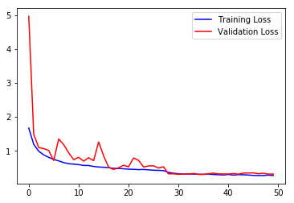
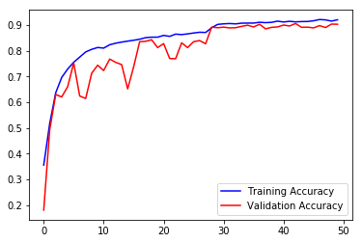
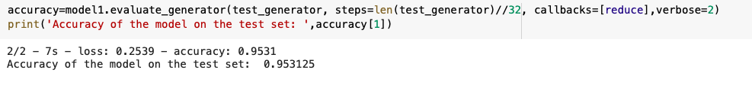
CNN Model Evaluation

Slide 11
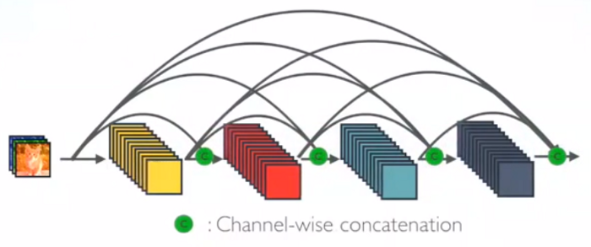
Dense Convolutional Network (DenseNet)
Each layer obtains additional inputs from all the preceding layers and passes on its own feature-maps to all subsequent layers.

Slide 12
Concatenation in DenseNet
Since each layer receives feature maps from all preceding layers, network can be thinner and compact, i.e. number of channels can be fewer. The growth rate k is the additional number of channels for each layer.

Slide 13
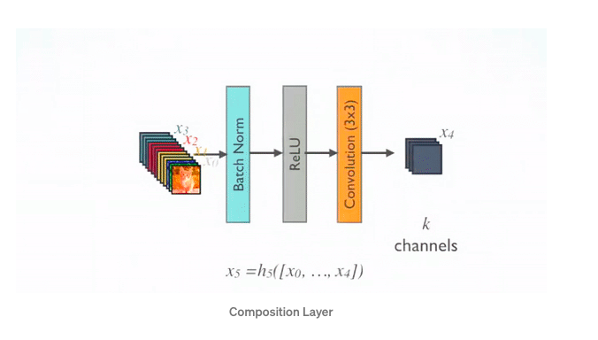
DenseNet Implementation
For each composition layer, Pre-Activation Batch Norm (BN) and ReLU, then 3×3 Conv are done with output feature maps of k channels.
To reduce the model complexity and size, BN-ReLU-1×1 Conv is done before BN-ReLU-3×3 Conv.

Slide 14
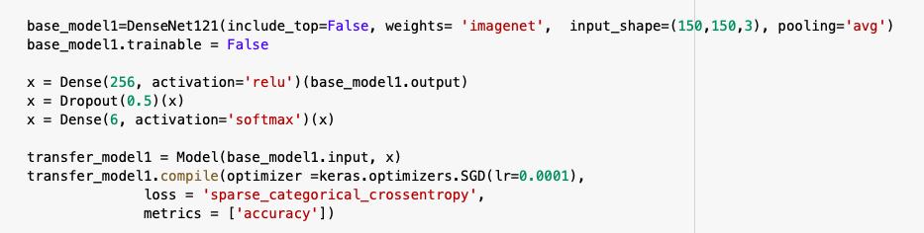
Optimizer

Slide 15
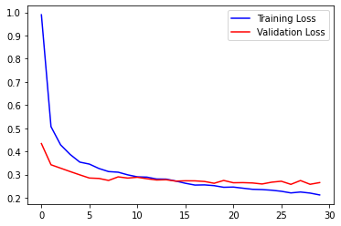
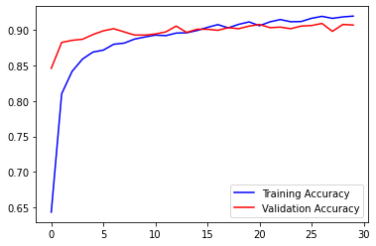
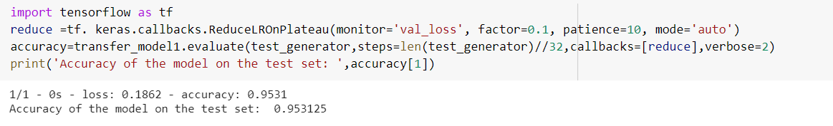
DenseNet Model Evaluation

Slide 16
Results / Comparison
MODEL | TEST_ACCURACY | TEST_LOSS
DenseNet | 95.3% | 18%
CNN | 92.1% | 25%
InceptionV3 | 92.4% | 19%

Slide 17
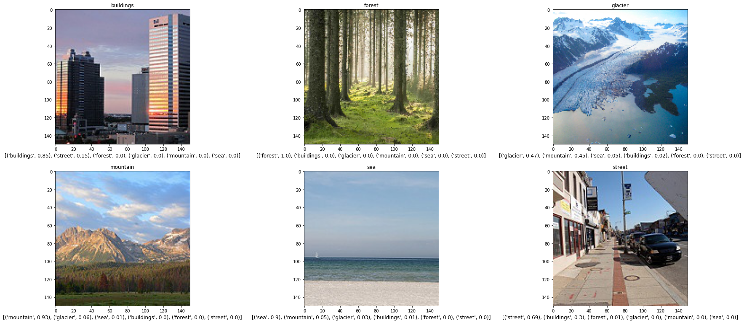
Results

Slide 18
Demo

